Slide 1
Welcome and Agenda Overview of Day 2
2nd W3C WoT Workshop, Munich, Germany, 4/5 June 2019

Slide 2
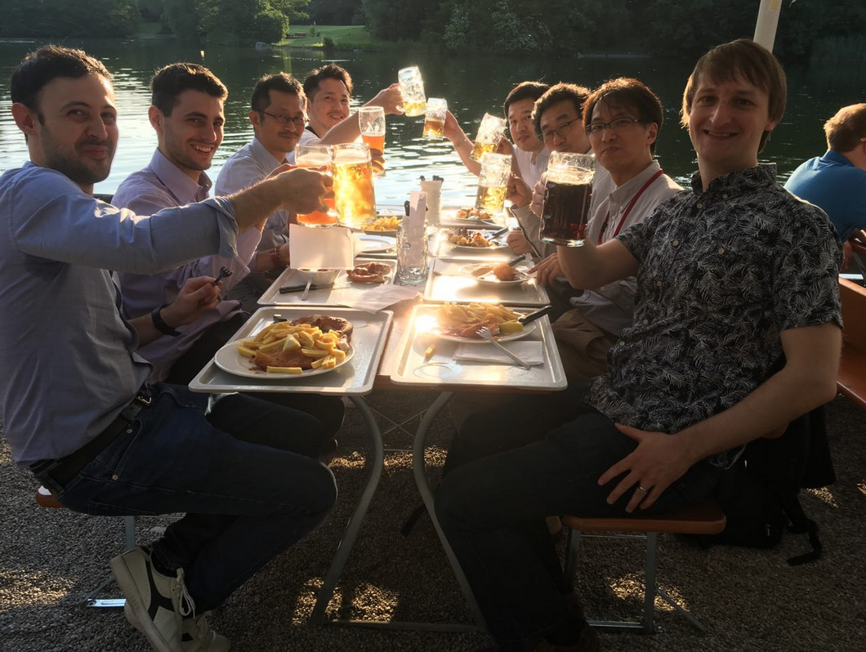
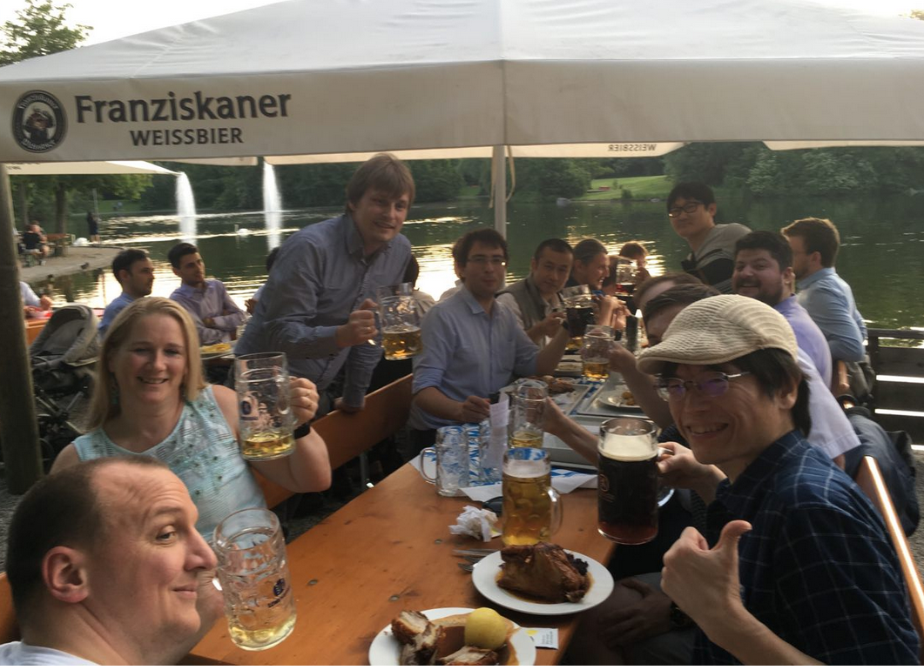
Remember?

Slide 3
<Agenda>

Slide 4
Contact
Kazuyuki Ashimura
W3C Staff
Web of Things Team Contact
ashimura@w3.org
team-wot@w3.org

